Slide 1
Circuit Builder Lab
Mrs. M I Youth Engagement Representative

Slide 2

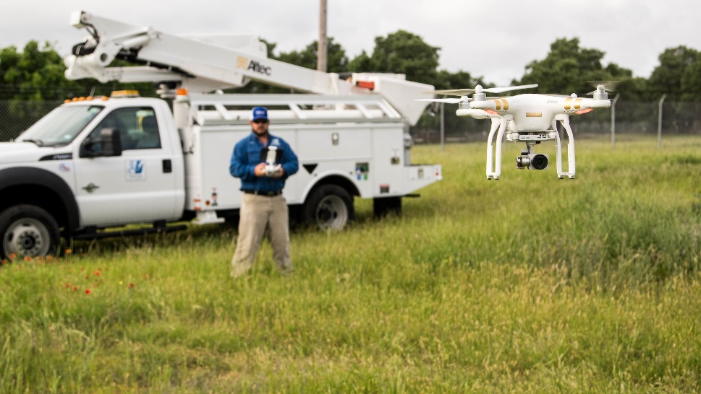

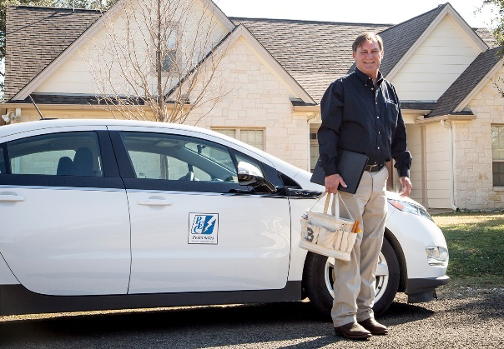
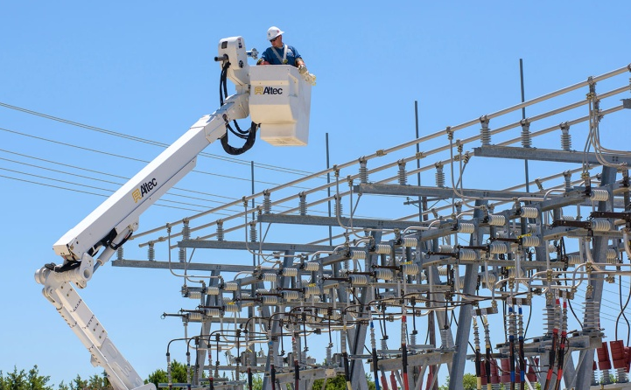
Slide title or headline

Slide 3
What is a circuit?
The pathway through which electricity flows is a circuit.
Three main parts of a circuit:
Power Source – Provides the power
Pathway – Allows the electricity to travel
Load – User of electricity

Slide 4
Series Circuit
+
—
+
—
—
Safety is FIRST, Batteries are LAST!

Slide 5

Series Circuit | Parallel Circuit | Switch Circuit
If one light bulb goes out, the other bulbs in the circuit go out too.
There is ONE path in a series circuit.
Old Christmas lights are the only example of a series circuit.

Slide 6
Parallel Circuit
+
—
+
—
—
—
Safety is FIRST, Batteries are LAST!

Slide 7
Series Circuit | Parallel Circuit | Switch Circuit
If one light bulb goes out, the other bulbs in the circuit go out too. | If one light bulb goes out, the other bulbs in the circuit remain on.
There is ONE path in a series circuit. | There is MORE THAN ONE path in a parallel circuit.
Old Christmas lights are the only example of a series circuit. | Ceiling fans and classroom lights are good examples of parallel circuits.

Slide 8
Switch Circuit
+
—
+
—
Safety is FIRST, Batteries are LAST!

Slide 9
Series Circuit | Parallel Circuit | Switch Circuit
If one light bulb goes out, the other bulbs in the circuit go out too. | If one light bulb goes out, the other bulbs in the circuit remain on. | The circuit can be opened or closed using a switch.
There is ONE path in a series circuit. | There is MORE THAN ONE path in a parallel circuit. | The switch serves as a pathway in the circuit.
Old Christmas lights are the only example of a series circuit. | Ceiling fans and classroom lights are good examples of parallel circuits. | The switch on a wall is a good example of a switch circuit.

Slide 10
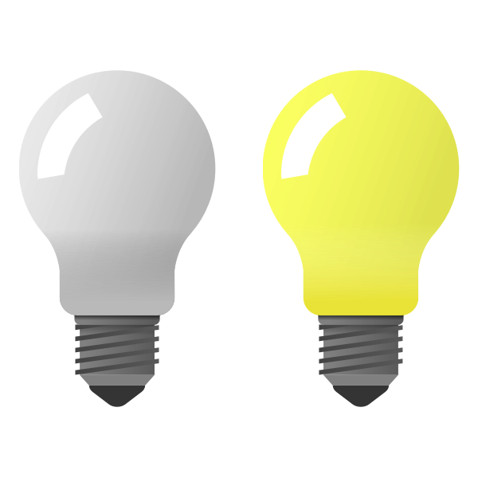
Conductors and Insulators
+
—
A conductor is a material that allows electricity to move through it easily.
+
—
An insulator is a material that DOES NOT allow electricity to move through it easily.
OBJECT
Safety is FIRST, Batteries are LAST!

Slide 11
A conductor is a material that allows electricity to move through it easily.
An insulator is a material that DOES NOT allow electricity to move through it easily.
Object | Type of Material (wood, metal, plastic, etc.) | Prediction (conductor or insulator) | Results (conductor or insulator)

Slide 12
POP QUIZ! Student construct a circuit using different colored lightbulbs. What will happen if switch 3 is closed and other switches are left open?
1
Only the green bulb will operate.
None of the bulbs will operate.
Only the green and yellow bulbs will operate.
Only the red and blue bulbs will operate.
2
+
—
—
+
—
—
3
Notes:
*These are questions taken from past TEKS tests!*
If there is time and have materials to collect answers, students can be “tested” on TEKs questions based on info learned in circuit lab.
Answer is C. Red and blue lights will not turn on because the switches leading to red and blue bulb is open.
Question asks student to assume switch 3 is closed. From battery, through switch to yellow light, then green light, to battery is a complete circuit. Thus, the answer is C.

Slide 13
POP QUIZ! Which of these changes to the electric circuit shown below will cause the lightbulb to light up?
—
+
Straightening the wire so that the current can flow more easily.
Adding a switch and more wire so that the current can flow more easily.
Turning one battery so that the positive end connects to the other battery’s negative end.
Making the length of the wire the same on both sides of the lightbulb.
+
—
Notes:
*These are questions taken from past TEKS tests!*
The answer is C.
The connection in the middle must always be negative to positive. Electricity flows negative to positive. If students construct circuit with two negatives in the middle or two positives in the middle, the light(s) will not turn on.
None of the other answers matter – straightening wire, adding switch, or length of wire…

Slide 14
POP QUIZ! The red lightbulb in the circuit below does not light up. Which statement explains this observation?
The battery is not charged.
The red lightbulb is not part of a complete circuit.
The circuit does not have a pathway.
The green lightbulb uses most of the energy from the battery.
+
—
Notes:
*These are questions taken from past TEKS tests!*
The answer is B.
The key word is COMPLETE circuit. The green light bulb is part of a complete circuit. The red lightbulb would need a pathway (wire) on the other side back to the battery to be complete. I sometimes ask student if the wire between the right side of the switch and battery was moved to the right side of the red lightbulb, would both lights turn on? The answer is yes.

Slide 15
POP QUIZ! The diagram shows an electric circuit with four lights that a student plans to build. When the student connects the wires as shown, which of the lights will light up?
+
—
Light 1 only
Lights 1 and 4 only
Lights 3 and 4 only
Lights 1, 2, 3, and 4
1
2
4
3
—
—
Notes:
*These are questions taken from past TEKS tests!*
The answer is B.
Lights 2 and 3 do not have a pathway (wire) on either side of the light leading back to the power source (battery).
The circuit is open on the right side of light bulb 2. The circuit is open on the left side of light bulb 3. The circuit is from the battery through light 1, light 4, and back to the battery.

Slide 16
Notes:
Thank the students for their time and participation.

